Slide 1


Slide 2
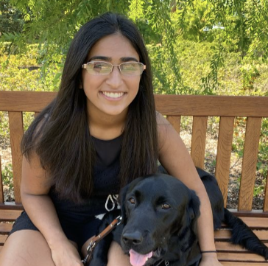



The COCODE team
Trisha K.
Daniel R.
Juliette W.
Angela C.

Slide 3
Value Proposition
Learn. Solve. Empower.

Slide 4
Solution Overview
We heard that students in computer science courses felt that they could not easily collaborate without experiencing imposter syndrome. We also heard that professors do not have the tools to support beneficial pair programming or collaboration that does not violate the honor code in their classes. We hope to create a platform on which students can collaborate anonymously or with their friends. Once they have mastered a concept, they can give back by teaching it to others who are still struggling. The platform is easy to manage and can be integrated into any CS course.

Slide 5
Brainstorming Tasks
Simple Tasks:
Join a randomly assigned study group
Find a practice coding problem
Find anonymous people to collaborate with
Browse the different concepts
Assign problems to student groups
Auto-grade answers
Moderate Tasks:
Track personal/group scores
Solve a regular coding problem
Complete an alternate line coding challenge with a teammate/friend
Complete a concept challenge with a teammate/friend
Create recurring anonymous study group
Alternate lines of code with the computer
Complex Tasks:
Choose a team based on personal criteria
Create coding/concept problems
Categorize problems
Complete an alternate line coding challenge with a stranger matched based on preferences
Manually grade answers
Track personal/group progress with strengths and weaknesses broken down

Slide 6
Three Finalist Tasks
Simple Task: Study with anonymous people
Moderate Task: Teaching/learning with study group/friend
Complex Task: Integrate a (flexible and manageable) collaborative component into the course

Slide 7
Video Planning Storyboards

Slide 8
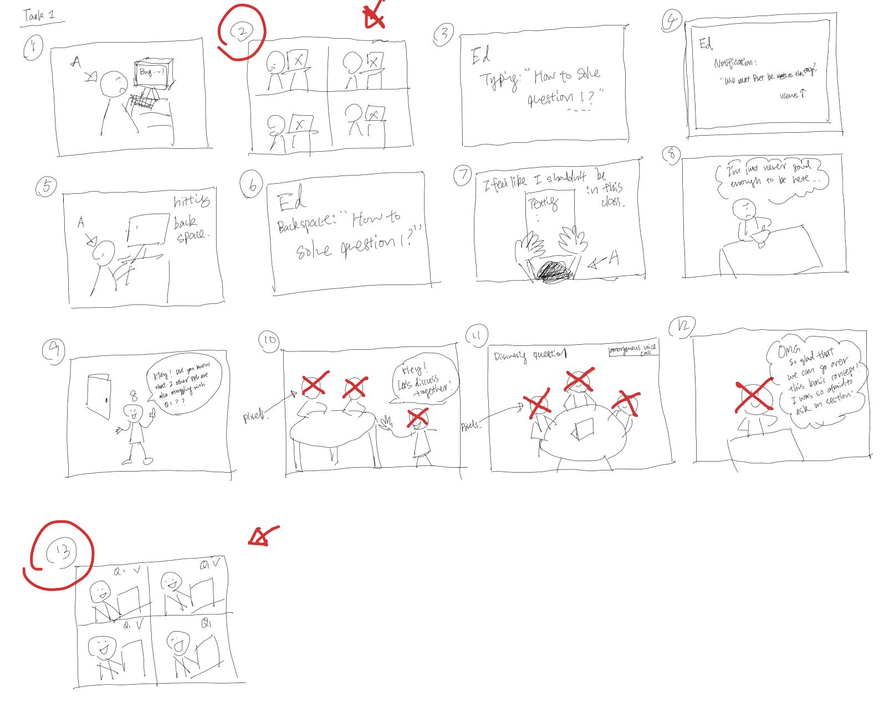
Task 1
Student A has a series of errors pop up as they try to debug something - look frustrated
Student A starts to type a question asking about some beginning part of the assignment
A post appears on Ed asking about question 8, while ABC etc are struggling with question 1 *views go up”
Student A dejectedly deletes their question
(Their reaction: I shouldn’t be in this class, I wonder if I’m the only one)
A texts friend (I’m so dumb… I don’t belong here), friend recommends Collabor8
A goes on Collabor8, joins an anonymous voice only discussion about question1, along with BC etc
They are smiling, chatting about the problem

Slide 9
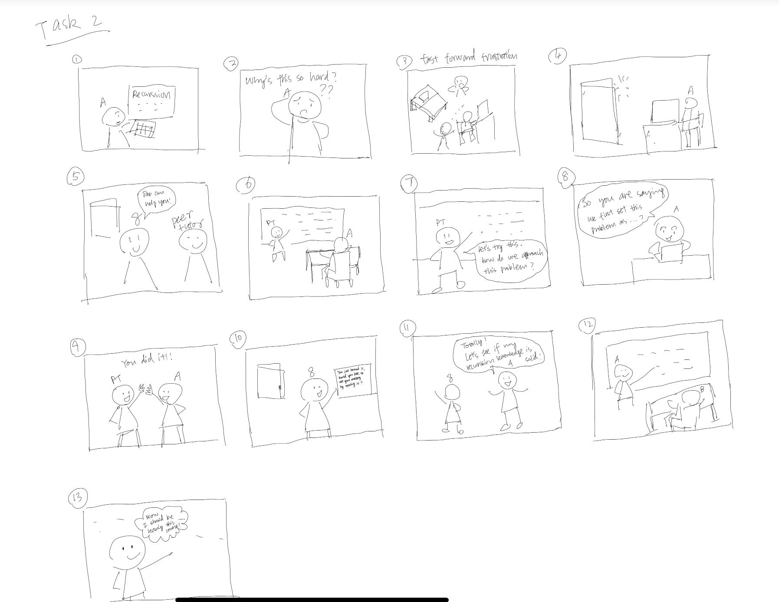
Task 2
Student A struggles with concept x
Student A goes on cocode and finds a teacher and learns the concept
A finishes their learning session
A gets a popup to the effect of “You just learned X. Would you like to test your mastery by teaching someone else?”
A chooses yes
A is enthusiastically teaching

Slide 10
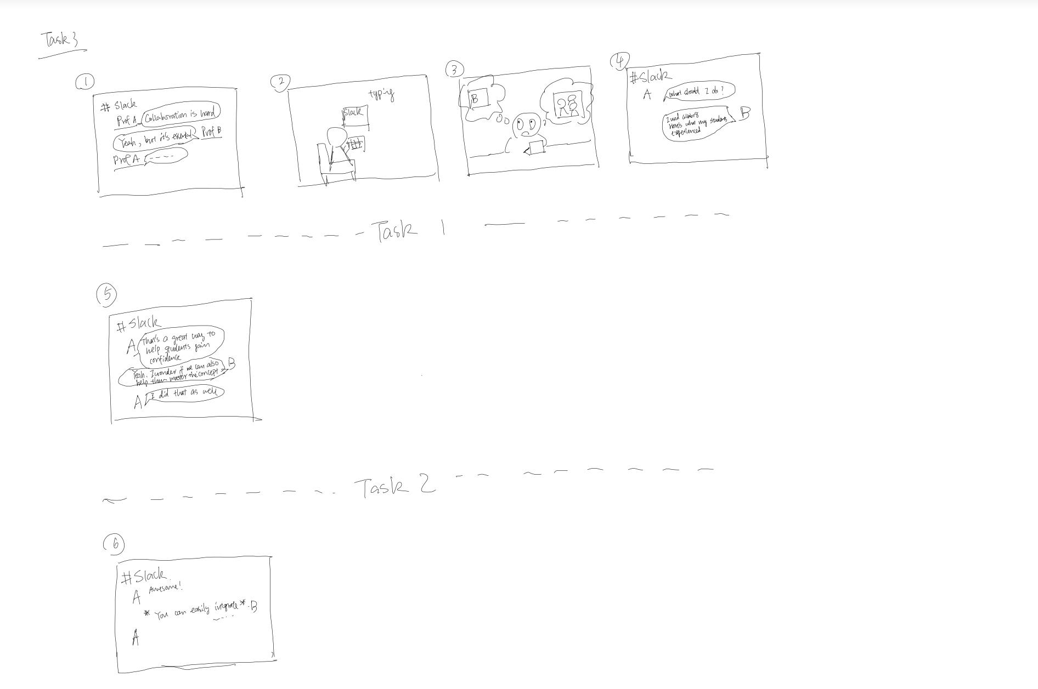
Task 3
Professor struggles to think of a good way to motivate students to collaborate.
She messages her professor friend on slack to ask for advice
The friend tells her about two features of cocode
The first message takes us into task 1
After task one, it comes back to the professors chatting on Slack. The professor friend explains another feature which leads into task 2
At the end of the video, the professor is excited to start using cocode

Slide 11
Appendix

Slide 12
Trisha K. , Daniel R., Juliette W., Angela C.
CS147 Winter 2021
https://hci.stanford.edu/courses/cs147/2021/wi/projects/education_technology/cocode

